Slide 1
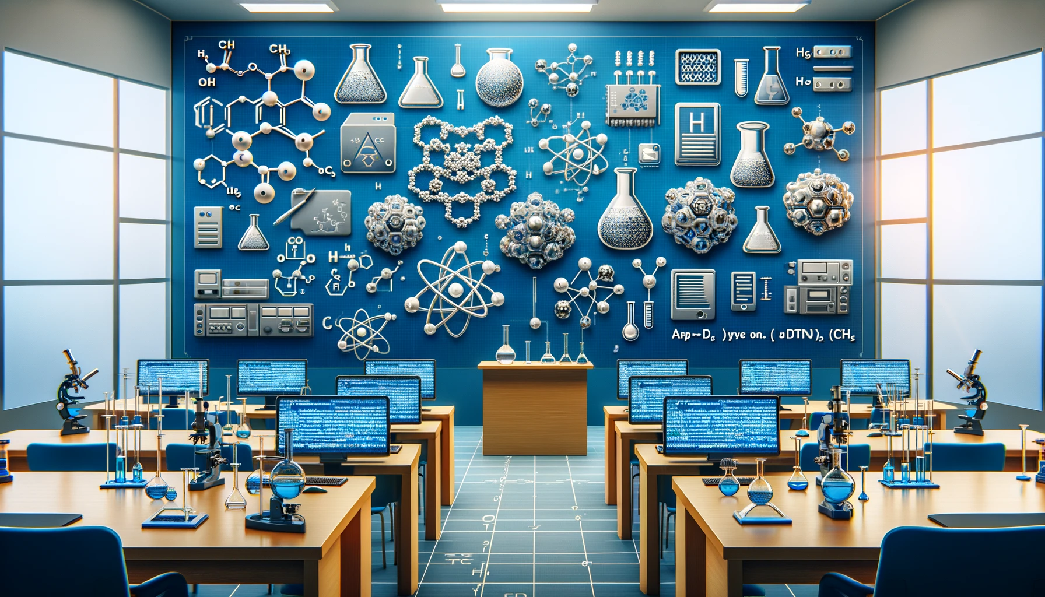

CHEM 4(6)PB3 pip install chemistry
Rodrigo A. Vargas Hernández
vargashr@mcmaster.ca
@RoVargasHdz

Slide 2

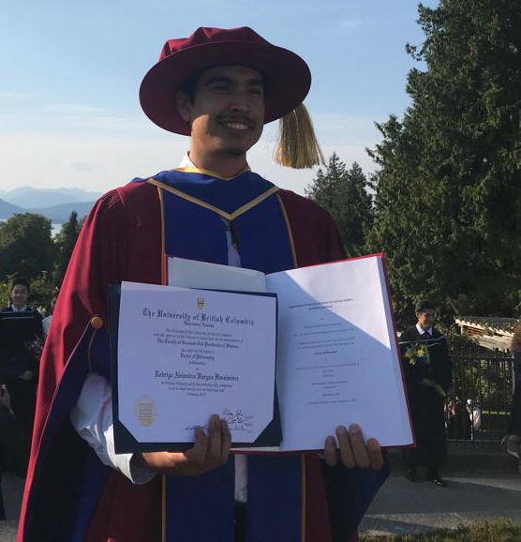
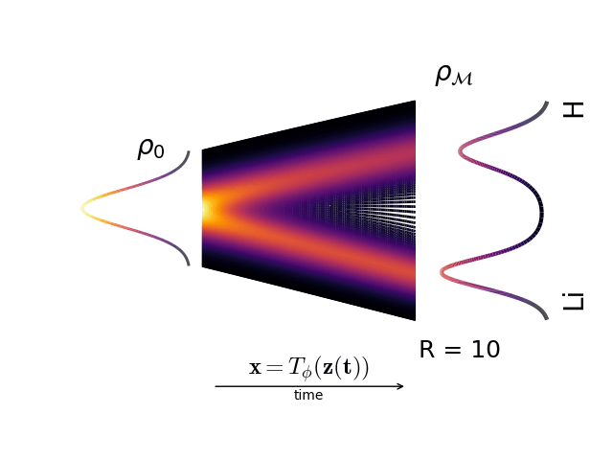
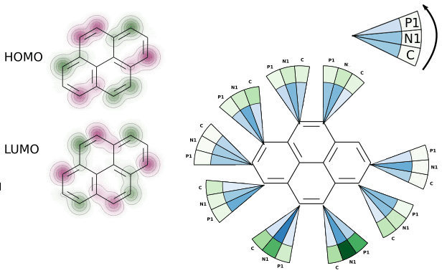
Who am I?
Born in Mexico city
Undergraduate: UNAM
comp. chemistry
PhD: UBC Vancouver, BC
ML/AI for Chemistry
Postdocs: UofT
more ML/AI and Chemistry
Hobbies: cycling and coffee
not me
ChemAI group
more** ML/AI and Chemistry/Physics
new comp. tools for simulating chemistry
Chem 4PB3 (chemoinf. + python + ML)

Slide 3
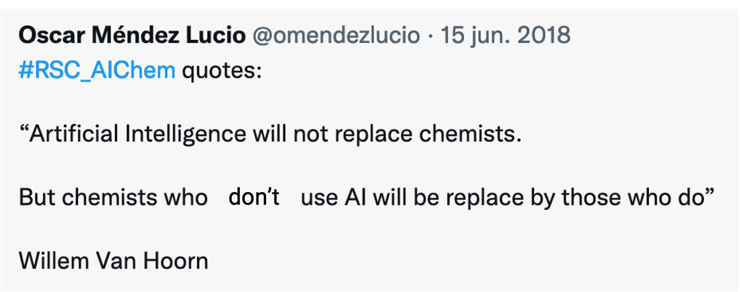
Goal
Do NOT be afraid of coding!
coding
new tools

Slide 4
Evaluation
Course component | Marks |  | Notes
Assignment 0 Deadline: Jan 24th | 0% |  | Warm up
(midterm) Assignment 1 Deadline: Feb 28th | 20% |  | (Haven’t designed yet) Load a data set. Basic data analysis Some simple model fitting
Final project Deadline: Final exam | Oral presentation | 20% | 25 min: 15 + 5 + 5
 | Code | 25% | Code (Google Colab)
 | Written report | 25% | Maximum 6 pages, without refs. single column
 | Total | 75%
Democracy | 10% |  | Feedback from the group and myself
* If you decide no to hand Assignment 1, do a super Final project.
There is no homework so there isn’t an excuse for
not spending time on your final project

Slide 5
Outline
Introduction to programming in Python
numpy, pandas, matplotlib, scipy
Recap of calculus and linear algebra
linear regression and gradient descent
Chemoinformatics
RDKit, PyMOL, …
Computational Chemistry*
Hartree-Fock and Density Functional Theory
*the depth will depend on how we advance in the course

Slide 6
Final Project
Undergraduates
team <= 2
Graduate students
team = 1
Examples:
Published paper: Reproduce part of a work.
Lab project: Automating data analysis
Model fitting
Comp. Chem.: Simulation of a series of compounds
Potential energy surface for a chem. rxn
Transition state search

Slide 7
Final Report
Section I: Introduction, literature review and problem statement (1.5 pages)
Section II: Hypothesis (0.5 pages)
Section III: Describe the model/data or chemical system (1 page)
Section IV: Results (2.5 pages)
Section V: Summary (1 page)
Section V: Future work (0.5 pages)
Section VIII: References (not included in the page limit)

Slide 8
Final Presentation
Time limit:
Total 25 minutes:
15-20 min: present your work
5-7 min: go-through a working demo using your (part) code
5 min: questions (part of your mark!)
Colab demo:
Google Colab demo that was used in your final project
(example) https://github.com/RodrigoAVargasHdz/steady_state_jax

Slide 9
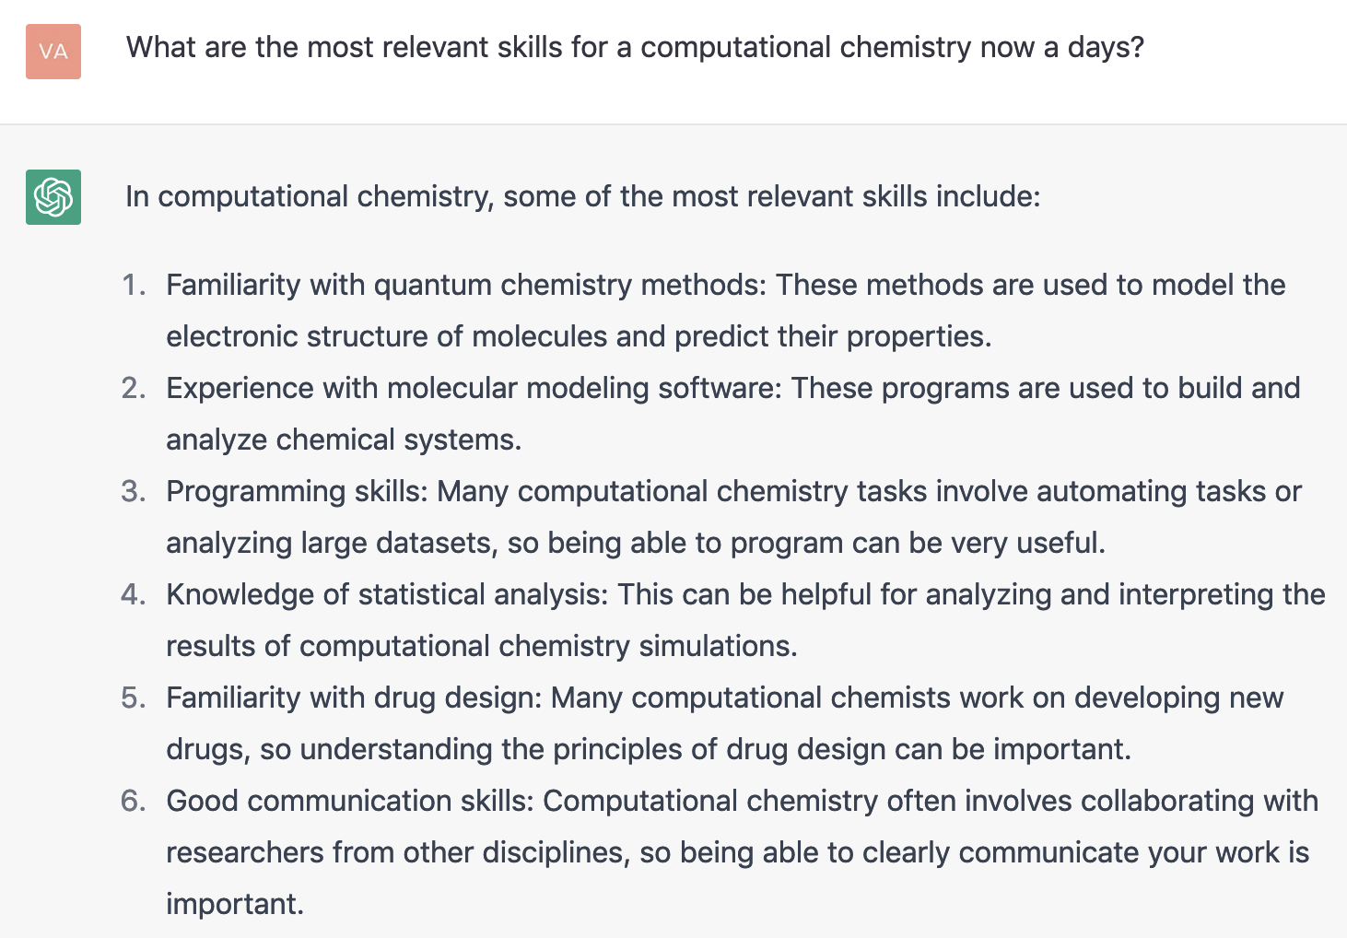

Slide 10
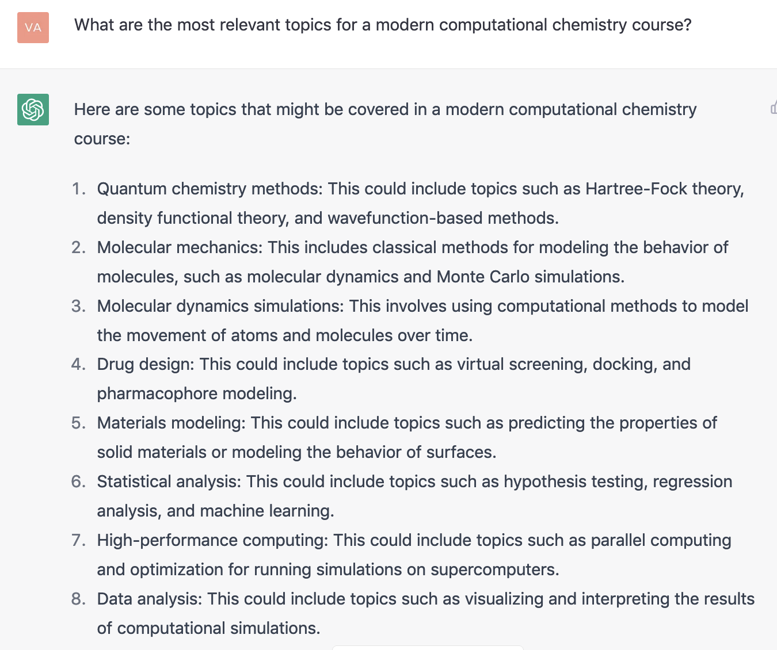

Slide 11
What do you want to learn?
This course is for you!

Slide 12
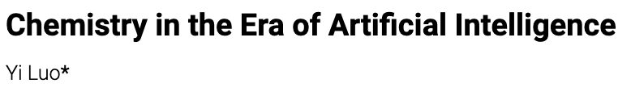
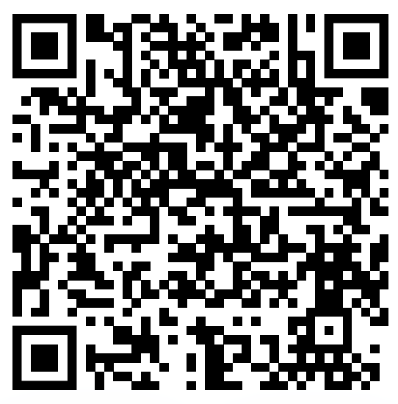

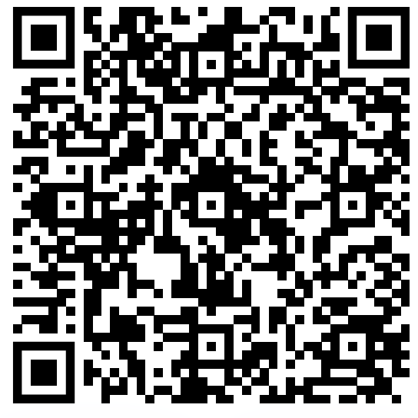
Questions about ML/AI?
How AI is Changing Chemical Discovery? Victor Hugo Cano Gil

Slide 13

AI in science and life

Slide 14
References
Use the internet!

